Slide 1
Making Data Into Charts
Using Microsoft Excel

Slide 2
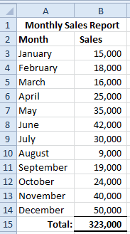
Organizing Your Data
The first step to creating a chart or graph is organizing your data. It can be organized either vertically or horizontally
Vertical
Horizontal

Slide 3
Organizing Your Data
Typically data is presented vertically
Once you have your data organized you can begin the process of making a chart
Vertical

Slide 4
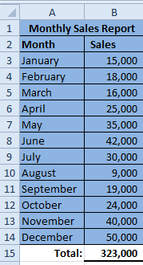
Pie Charts
We will begin with a Pie Chart
A Pie Chart shows the part of the whole
Step 1: Select the titles and the data (DO NOT select the “Total(s)”, you only want the data in a Pie Chart.)
Select the data and your titles
Do not select the totals

Slide 5
Pie Charts
Step 2: Click the Insert tab on the Ribbon Click “Pie” in the Charts group
Click “Insert” tab
Click “Pie”
Charts Group

Slide 6
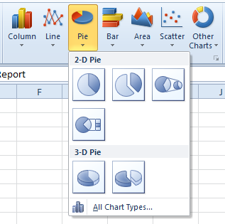
Pie Charts
Step 3: Click the first 2-D Pie in the list

Slide 7
Pie Charts
Step 4: Voilà…a Pie Chart

Slide 8
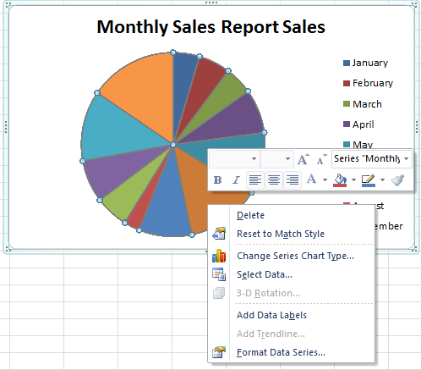
Pie Charts
Step 5: If you want labels on the “pieces” of the Pie, position your mouse pointer over the pie and click the right mouse button
Step 6: Click “Add Data Labels” in the pop-up menu

Slide 9
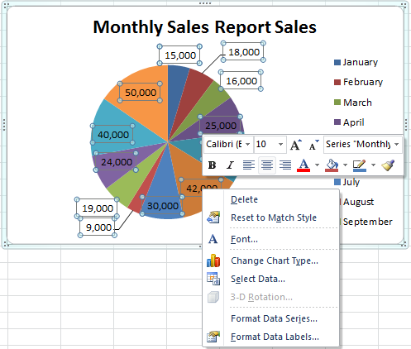
Pie Charts
Step 7: Now your chart should look like the one below If you want to change the labels just right click on one of the labels in the chart and click “Format Data Labels”

Slide 10
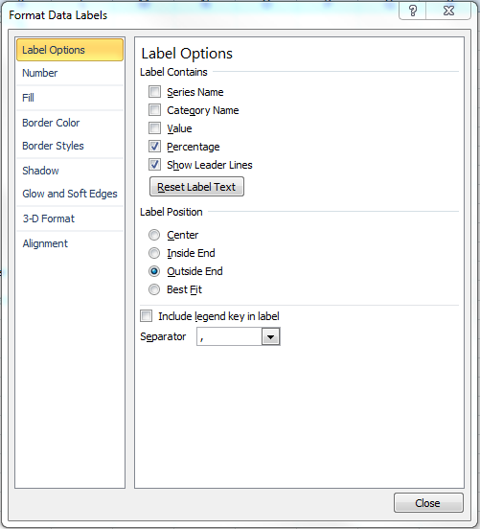
Pie Charts
Step 8: In the Format Data Labels Dialog Box, in the Label Options group you can choose a variety of label contents including
Series Name
Category Name
Value
Percentage
In this case we will use Percentage and make sure that there is a check mark in “Show Leader Lines”
Step 9: In the Label Position group choose “Outside End”
Step 10: Click “Close”

Slide 11
Pie Charts
Here is your new chart

Slide 12
Single Line Chart
Just like the Pie Chart
Step 1: Select the titles and the data (DO NOT select the “Total(s)”, you only want the data in your chart.)
Select the data and your titles
Do not select the totals

Slide 13
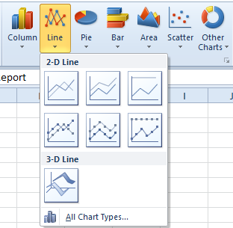
Single Line Chart
Step 3: Click the first 2-D Line in the list

Slide 14
Single Line Chart
Step 4: Voilà…a Line Chart

Slide 15
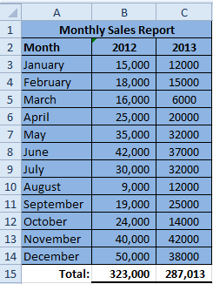
Multiple Line Chart
When you have Multiple Line Charts you are comparing data. For Instance comparing sales from one year to another and in this case we will be comparing 2011 to 2012 sales
Step 1: Select the titles and the data for both years (DO NOT select the “Total(s)”, you only want the data in your chart.)
Select the data and your titles

Slide 16
Multiple Line Chart
Step 3: Click the first 2-D Line in the list

Slide 17
Multiple Line Chart
Step 4: Voilà…a Multiple Line Chart

